Slide 1

Analysis and Simulation of Interest Rates
Uday Pratap Singh

Slide 2
Key Points on Treasury Yields:-
The Treasury yield is the interest rate that the government pays to borrow money for different lengths of time.
Each of the Treasury securities (T-bonds, T-bills, and T-notes) has a different yield; longer-term Treasury securities usually have a higher yield than shorter-term Treasury securities.
Treasury yields reflect how investors feel about the economy; the higher the yields on long-term investments the more optimistic their outlook.
Treasury Yield = [C + ((FV - PP) / T)] ÷ [(FV + PP)/2]
where C= coupon rate, FV = face value, PP = purchase price
T = time to maturity
Notes:
Reference=> https://www.investopedia.com/terms/t/treasury-yield.asp#:~:text=Treasury%20yield%20is%20the%20return,for%20different%20lengths%20of%20time.

Slide 3
Intro:-
To analyze the Interest Rate, I chose the following bonds and selected the 1-year time period:-
1-Year Treasury Constant Maturity Rate (DGS1)
5-Year Treasury Constant Maturity Rate (DGS5)
10-Year Treasury Constant Maturity Rate (DGS10)
30-Year Treasury Constant Maturity Rate (DGS30)
Notes:
Reference=> https://fred.stlouisfed.org/series/

Slide 4

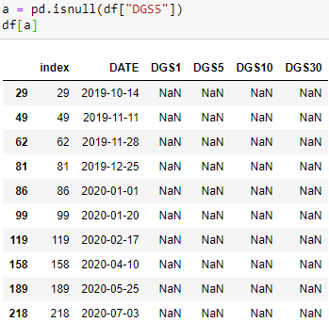
MISSING VALUES:-

Slide 5
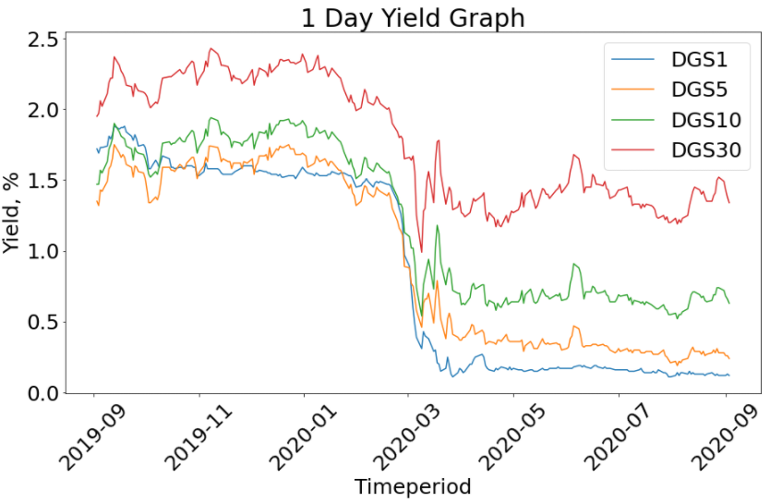
1 Day yield graph:-

Slide 6
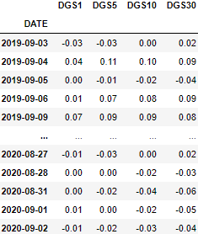
1 Day yield percent Increment data file(df):-

Slide 7
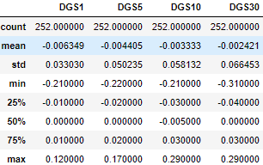
Extracted info for df:-

Slide 8
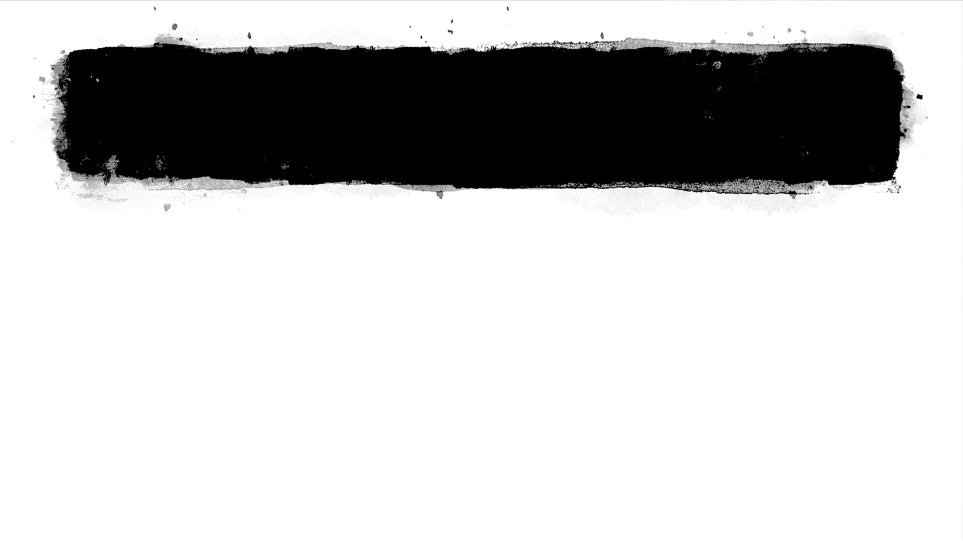
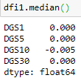
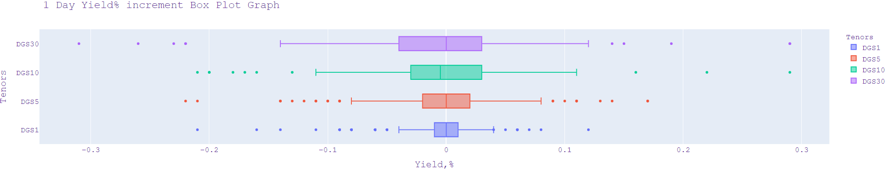
Box Plots for 1-day yield percent increment:-

Slide 9
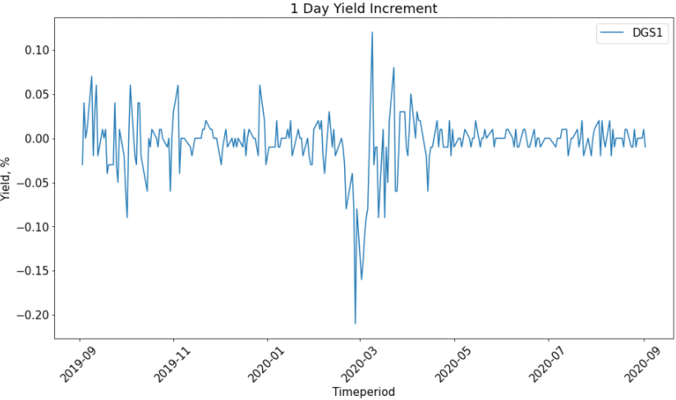
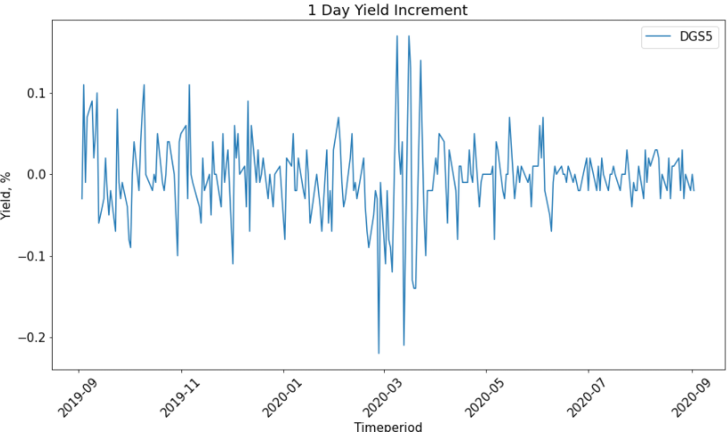
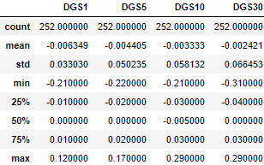
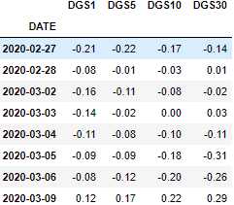
1 Day yield percent increment graph:-

Slide 10
1 Day yield percent increment graph:-

Slide 11
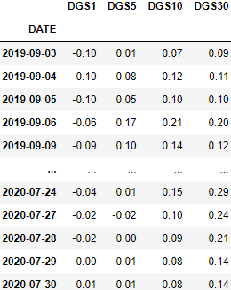
25 Day yield percent Increment Data file (df25):-

Slide 12
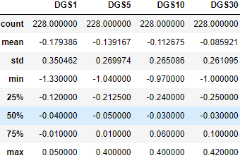
Extracted info for df25:-

Slide 13
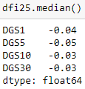
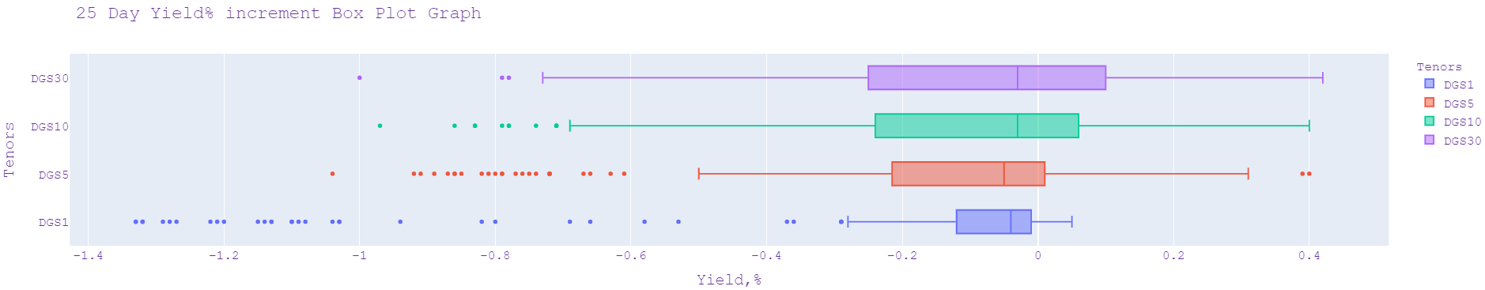
Box Plots for 25-day yield percent increment:-

Slide 14
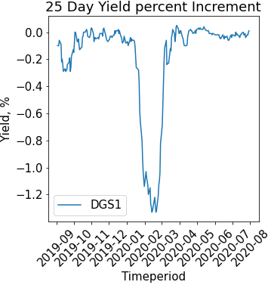
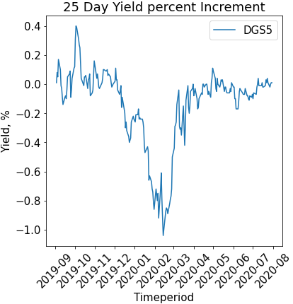
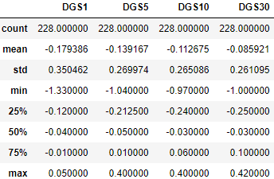



25 Day yield percent increment graph:-

Slide 15
25 Day yield percent increment graph:-

Slide 16
Distribution fit for 1-year bond, with 1-day yield percent increment:-

Slide 17
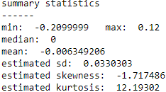
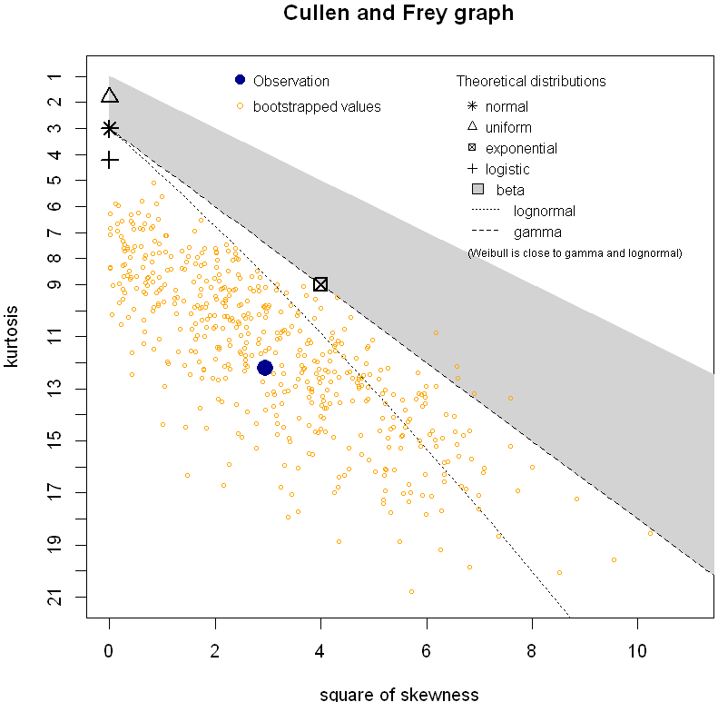
Cullen and Frey Graph:-

Slide 18
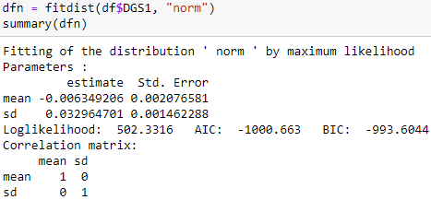
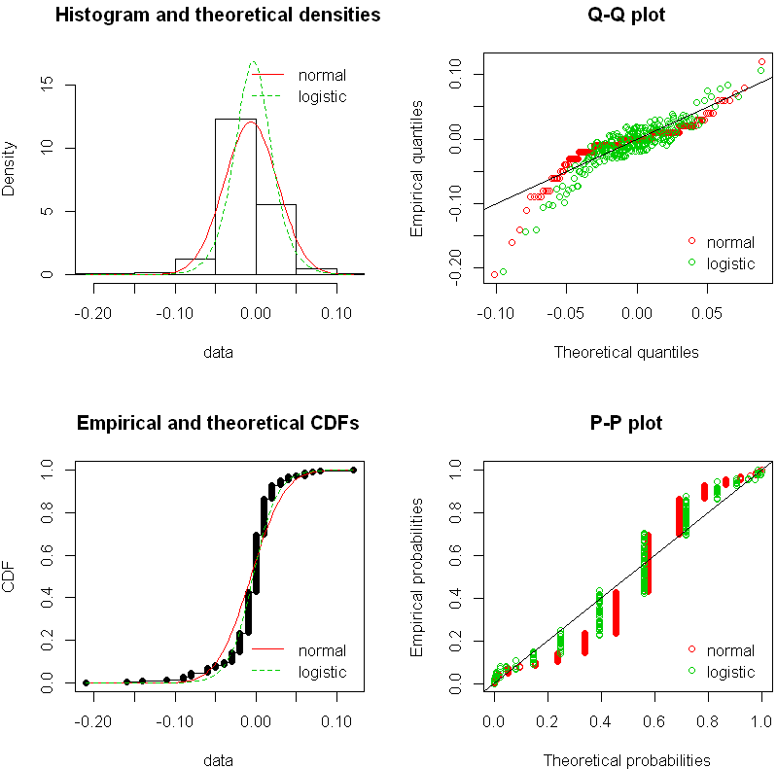
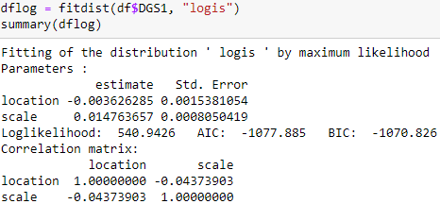
Multiple distributions on multiple plots:-

Slide 19
Distribution fit for 5-year bond, with 1-day yield percent increment:-

Slide 20
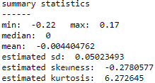
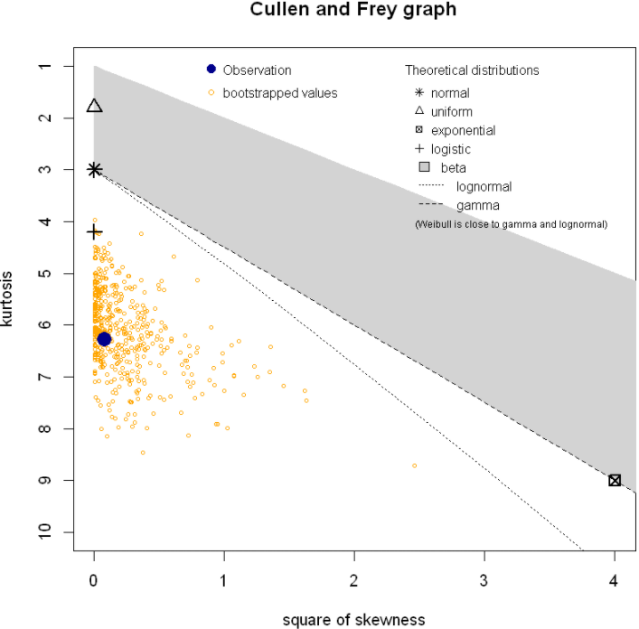
Cullen and Frey Graph:-

Slide 21
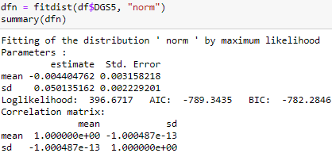
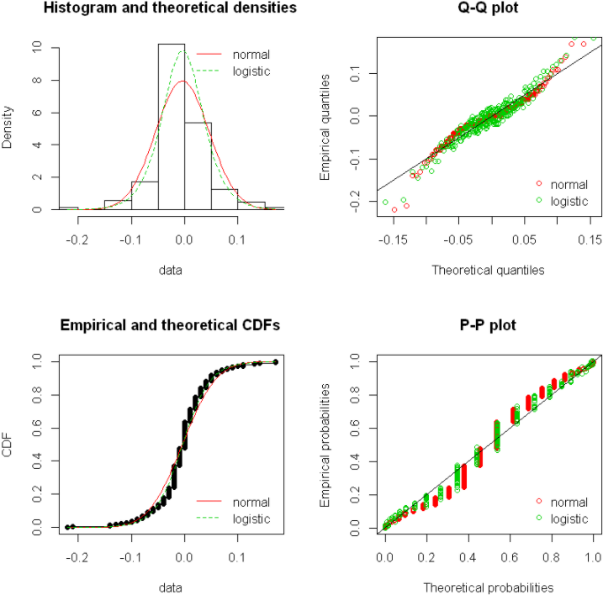
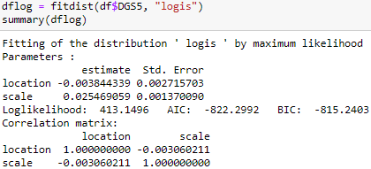
Multiple distributions on multiple plots:-

Slide 22
Distribution fit for 1-year bond, with 25-day yield percent increment:-

Slide 23
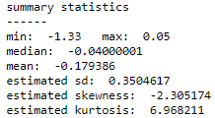
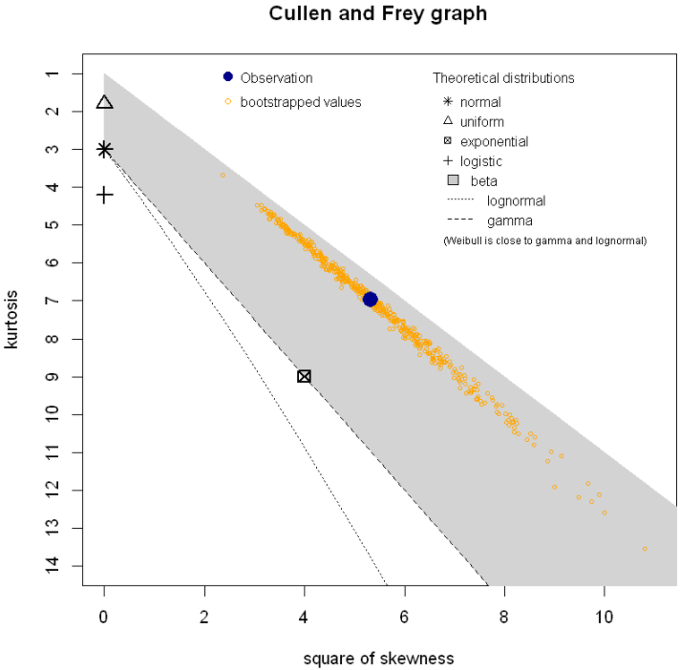
Cullen and Frey Graph:-

Slide 24
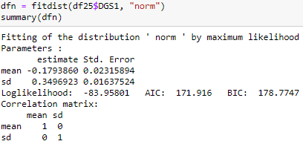
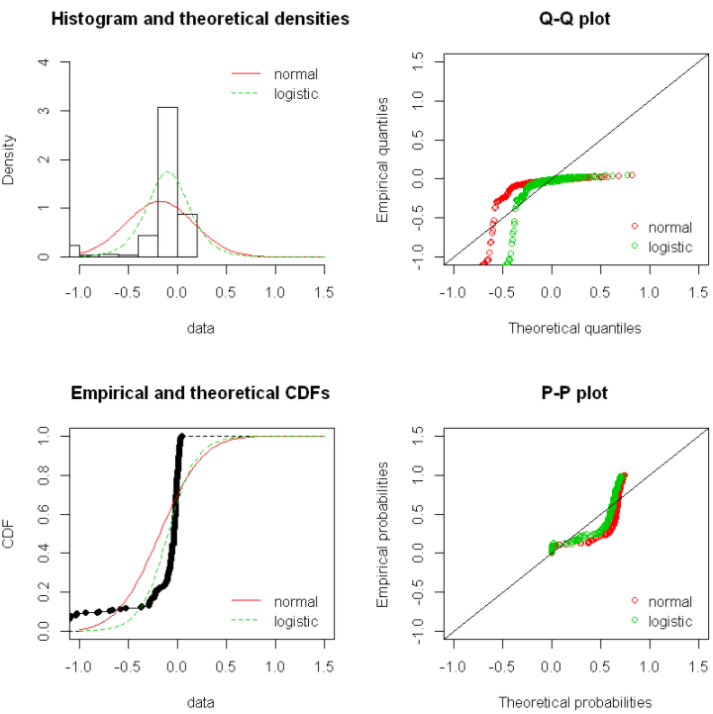
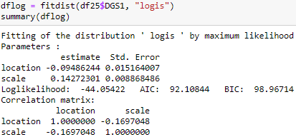
Multiple distributions on multiple plots:-

Slide 25
Distribution fit for 5-year bond, with 25-day yield percent increment:-

Slide 26
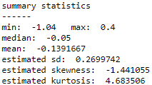
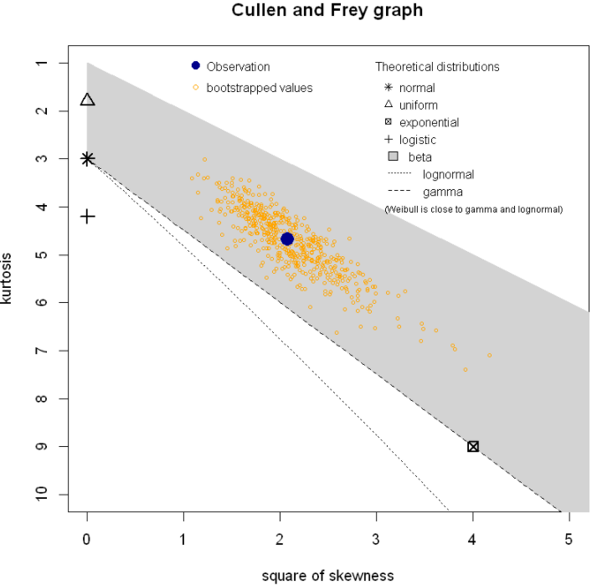
Cullen and Frey Graph:-

Slide 27
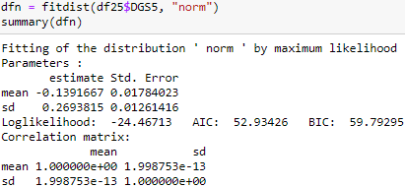
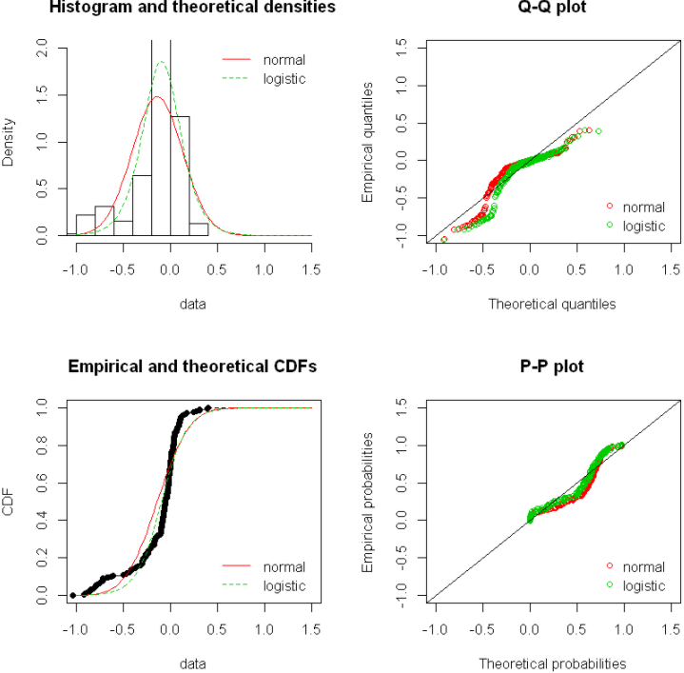
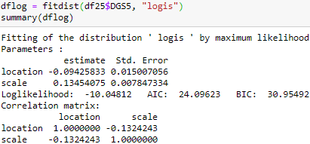
Multiple distributions on multiple plots:-

Slide 28
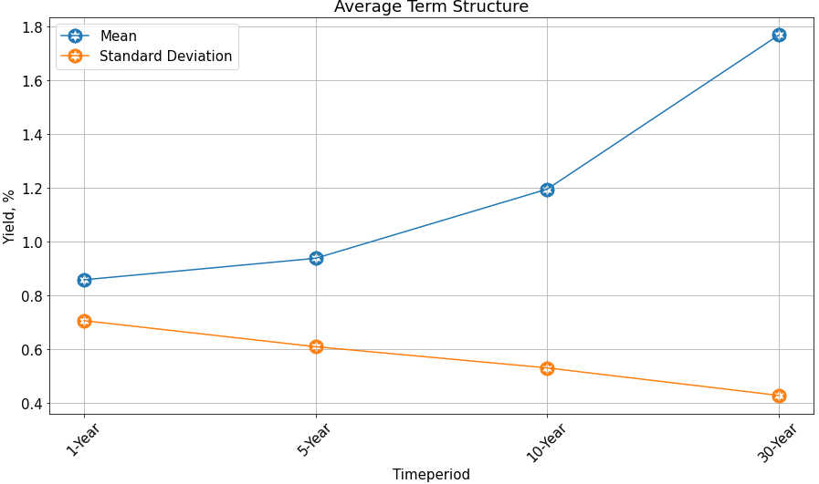
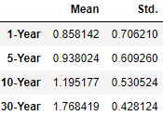
Average term structure of yield and standard deviation:-

Slide 29
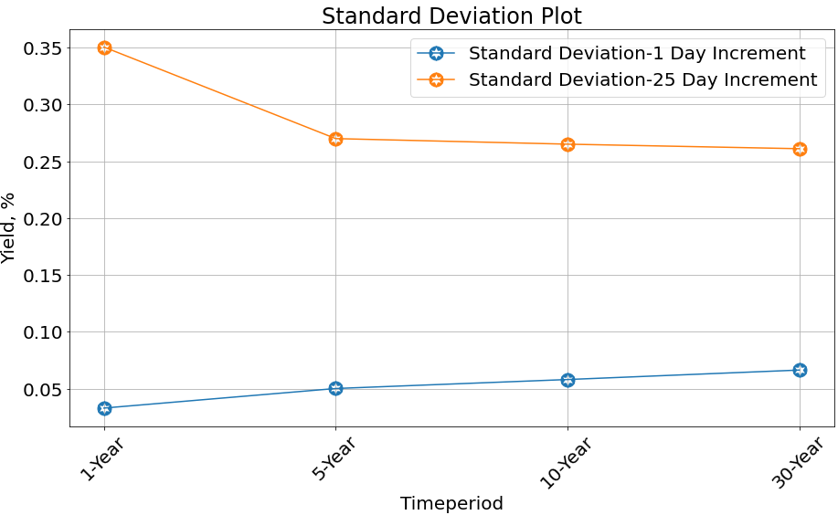
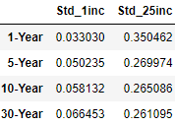
Standard Deviation for multiple tenors with 1-Day & 25-Day increment:-

Slide 30
Correlation Matrix:-

Slide 31
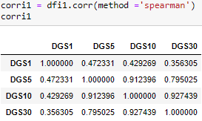
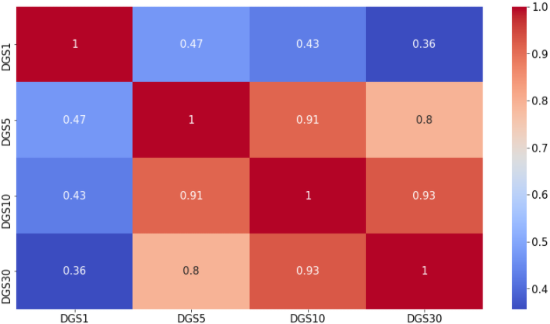
Correlation Matrix, for 1-Day increment:-

Slide 32
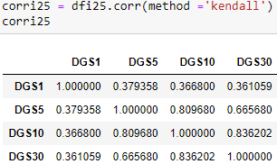
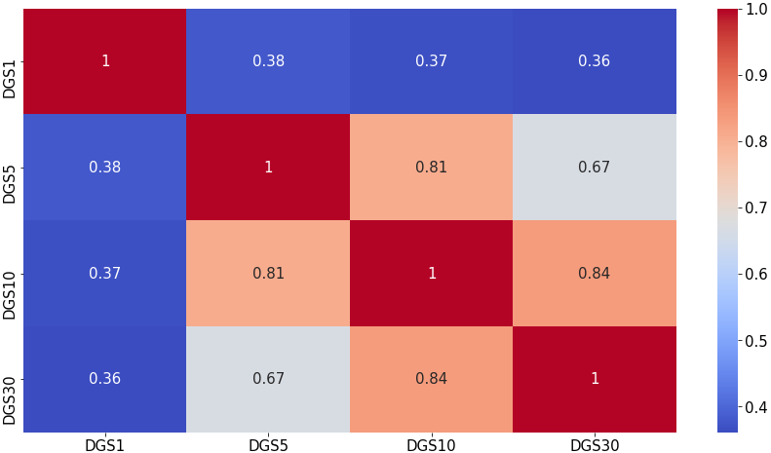
Correlation Matrix, for 25-Day increment:-

Slide 33
Principal Component Analysis:-

Slide 34
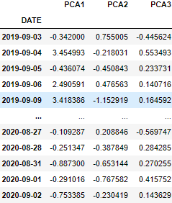
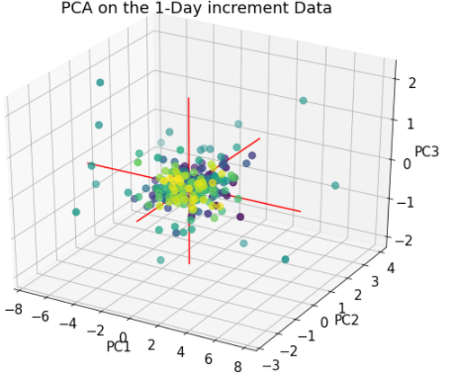
For 1-Day increment:-

Slide 35
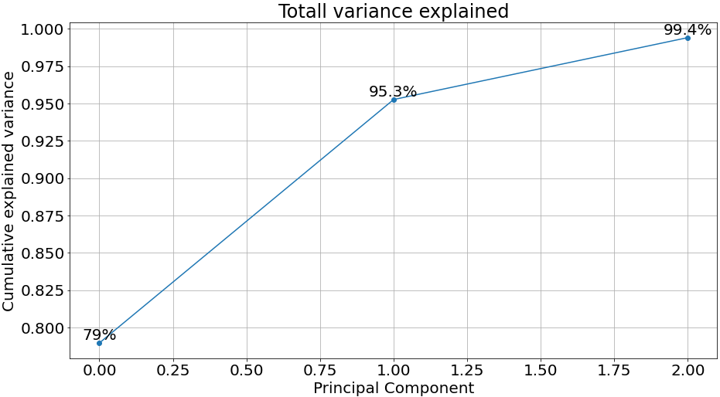
For 1-Day increment:-

Slide 36
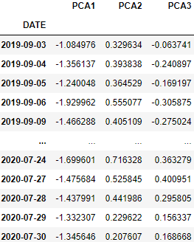

For 25-Day increment:-

Slide 37

For 25-Day increment:-

Slide 38
Short-Rate Model
Multi-Factor Model
Single Factor Model

Slide 39

Single Factor Stochastic Model:-
Stochastic modeling is a helpful tool for making investment decisions.
Using this we can forecast the outcomes as per different conditions, using random variables
Vasicek Interest Rate Model:-
This is a mathematical method of modeling interest rate, using the following equation:-
$$drt=k\left(θ−rt\right)dt+σdW$$
where:
W=Random market risk (represented by a Wiener process)
t=Time period
$k\left(θ−rt\right)$=Expected change in the interest rate at time t (the drift factor)
$k$=Speed of the reversion to the mean
$θ$=Long-term level of the mean
σ=Volatility at time t​
$d$, refers to the derivative of the variable following it
Also, this equation can only take one market risk factor at a time.
Notes:
Reference=> https://www.investopedia.com/terms/t/treasury-yield.asp#:~:text=Treasury%20yield%20is%20the%20return,for%20different%20lengths%20of%20time

Slide 40

Single Factor Stochastic Model:-
The rate paths are simulated using the following equation:-
Notes:
Reference=> https://www.investopedia.com/terms/t/treasury-yield.asp#:~:text=Treasury%20yield%20is%20the%20return,for%20different%20lengths%20of%20time.

Slide 41

From the last observed value, for DGS1:-

Slide 42

From the last observed value, for DGS5:-

Slide 43

From the last observed value, for DGS10:-

Slide 44

From the last observed value, for DGS30:-

Slide 45

Multi-Factor Model
Chen Model
Longstaff-Schwartz Model
The Longstaff-Schwatz is a two-factor model.
$$dXt=\left(at−bXt\right)dt+√XtctdW1t$$
$$dYt=\left(dt−eYt\right)dt+√YtftdW2t$$
Where the short rate is as follows:-
$$drt=\left(µX+ӨY\right)dt+σt√YdW3t$$
The Chen is a three-factor model, also called ‘stochastic mean and stochastic volatility model’.
$$drt=\left(Өt−at\right)dt+√rtσtdWt$$
$$dat=\left(Ȼt−at\right)dt+√atσtdWt$$
$$dσt=\left(βt−σt\right)dt+√σtntdWt$$
Notes:
Reference=> https://en.wikipedia.org/wiki/Short-rate_model#Multi-factor_short-rate_models

Slide 46
Conclusion:-
Through the gained knowledge, I will say that the Multi-factor model are preferred over the single factor model, because they are better consistent with actual yield curve moments.
The distribution fit for 1-year & 5-year was Logistic.
The average mean ascend and average standard deviation descend with the increasing Tenors.
The PCA with 3 components can be used for both 1-day & 25-day increment, because of acceptable Total variance explained.

Slide 47
Thank You

